Slide 1

CCS Fundamentals for MSP432
Excised and modified from the Lab Handbook portion of a TI workshop
Dr. Nabeeh Kandalaft EGR226 Grand valley State University

Slide 2



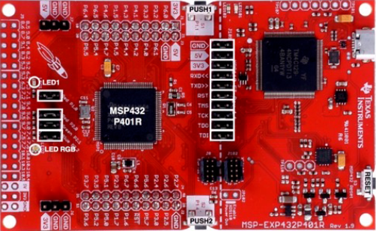
LAB Requirements
Software:
Code Composer Studio v6.1.2 or most recent release
Hardware:
MSP432P401R LaunchPad
USB
JTAG Connection
Dr. Nabeeh Kandalaft EGR226 Grand valley State University

Slide 3
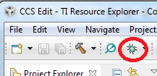
Debug msp432p401_1 Project
Press the Debug button to build and debug the project
Several actions are done automatically
Prompt to save source files (if needed)
Build the project (incrementally)
Start the debugger (CCS will switch to the CCS Debug perspective)
Connect CCS to the target
Load (flash) the program on the target
Run to main
Don’t want it to do all of the above at once? You can configure it to skip some steps (Debugger Options)
Dr. Nabeeh Kandalaft EGR226 Grand valley State University

Slide 4
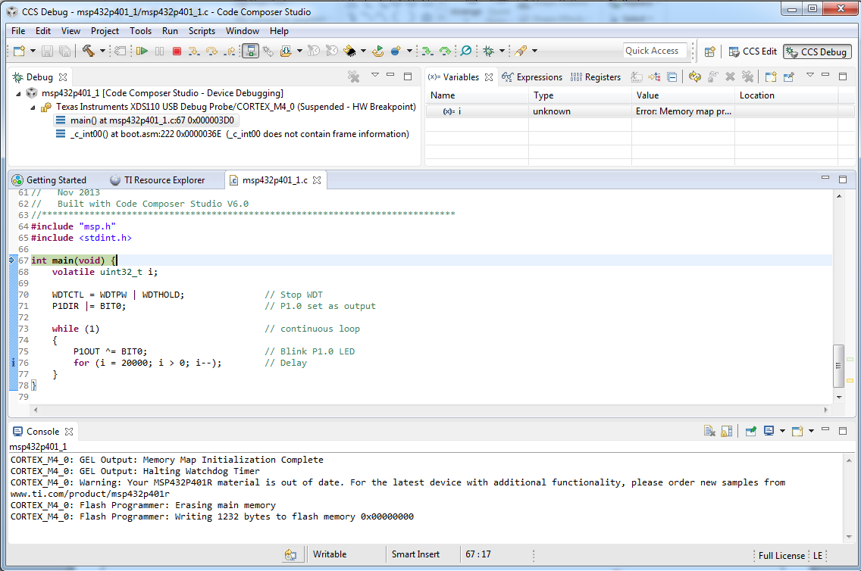
Debug Session for msp432p401_1 Project
Target execution toolbar
Switched to CCS Debug perspective
Debug view for project being debugger
Program counter at main
Debug messages in the Console view
Dr. Nabeeh Kandalaft EGR226 Grand valley State University
Notes:
4

Slide 5
Run msp432p401_1 Program
Press the Resume button (in the target execution toolbar) to run the program
Program will run and blink LED1
Dr. Nabeeh Kandalaft EGR226 Grand valley State University
Notes:
5

Slide 6
Breakpoints Types
Software (SW) Breakpoints
Implemented as an opcode replacement
Limited to RAM
(Generally) no limit to the number of software breakpoints available
Intrusive
Hardware Breakpoints
Implemented internally by the hardware (on-chip emulation module)
Limited number (varies with on-chip emulation module)
Two types of hardware breakpoints
Program: Monitor activity at a program address (or addresses)
Data: Monitor activity at a data address (also known as ‘watchpoints’)
Non-intrusive
http://processors.wiki.ti.com/index.php/How_Do_Breakpoints_Work#Hardware_vs._Software_Breakpoints
Dr. Nabeeh Kandalaft EGR226 Grand valley State University
Notes:
6

Slide 7
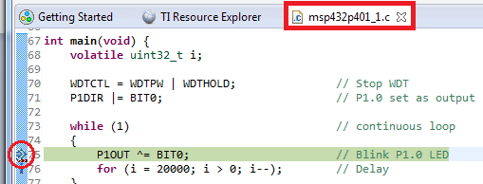
Debugging: Using Breakpoints
Set a breakpoint on line 75 of msp432p401_1.c by double-clicking in the editor margin
This will place a hardware breakpoint at line 75 and the target will halt there shortly afterwards
The default behavior is to use a software breakpoint unless the program address is in a memory region known to the debugger as read-only memory (as in this case) by the debugger memory map
Press the Resume button to run the program again
Note that the target will be halted at the breakpoint again after toggling the LED
Dr. Nabeeh Kandalaft EGR226 Grand valley State University
Notes:
7

Slide 8
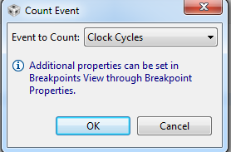

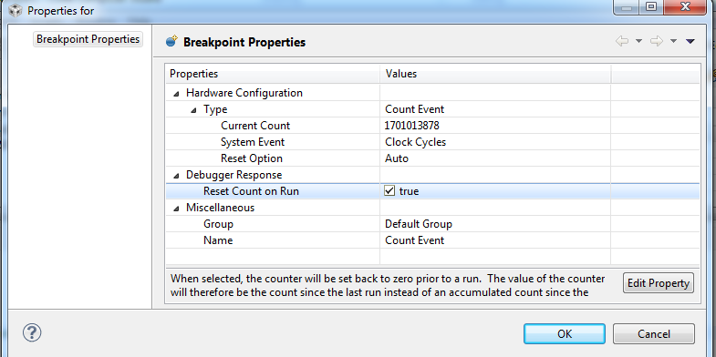
Debugging: Counting Events
Open the Breakpoints view via View -> Breakpoints
Set an event counter to count cycles
Right-click on the event counter in the Breakpoints view and select Breakpoint Properties in the context menu
Enable the Reset Count on Run option in the properties dialog
Press OK
Dr. Nabeeh Kandalaft EGR226 Grand valley State University

Slide 9
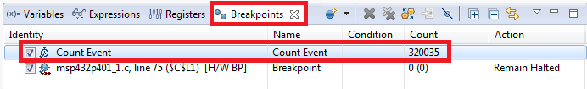
Debugging: Counting Events
Run the target again
The target will halt at the breakpoint and the event counter will display the number of cycles executed since the last time the target was halted: ~320000 cycles
Dr. Nabeeh Kandalaft EGR226 Grand valley State University
Notes:
9

Slide 10

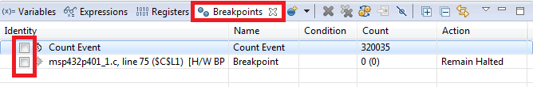
Modify LED Blink Rate
The blink rate of the LED can be modified by changing the delay value in the loop
Modify line 76 in msp432p401_1.c
From: for (i = 20000; i > 0; i--); // Delay
To: for (i = 10000; i > 0; i--); // Delay
Save msp432p401_1.c (File -> Save)
In the Breakpoints view, disable the breakpoint and event counter by unchecking the checkboxes for them
Click on the Terminate button
This will terminate the debug session and switch to the CCS Edit perspective
Dr. Nabeeh Kandalaft EGR226 Grand valley State University
Notes:
10

Slide 11

Rebuild, Reload and Run the Program
Make sure you are in the CCS Edit perspective and project sp432p401_1 is active (in focus)
Click the Debug button to rebuild the project and reload the code
Press the Resume button to run the program
The LED on the Launchpad should now be blinking at a faster rate since the number of loops was decreased between LED toggles
If it is not blinking, remember to disable (not delete) the breakpoints set in the previous session!
Dr. Nabeeh Kandalaft EGR226 Grand valley State University
Notes:
11

Slide 12
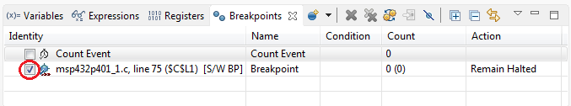

Re-enable Breakpoint and Counter
Enable just the breakpoint in the Breakpoints view and wait for the program to halt
Program will be halted at line 75
Enable the event counter in the Breakpoints view and run the target again
Note how the event counter now displays a value of ~160000 (roughly half
of value as before since we reduced the loop count by half)
Dr. Nabeeh Kandalaft EGR226 Grand valley State University
Notes:
12

Slide 13
Clean Up
Remove all entries from the Breakpoints view
Terminate the Debug Session
This will terminate the debug session and switch to the
CCS Edit perspective
Dr. Nabeeh Kandalaft EGR226 Grand valley State University

Slide 14
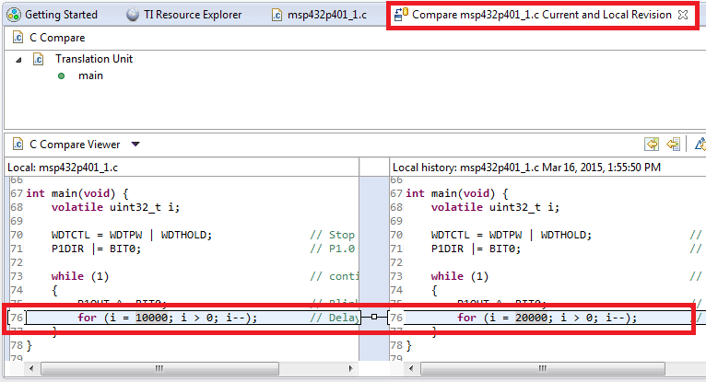
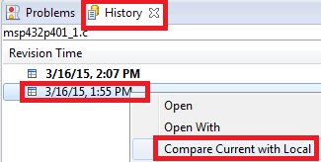
Restore From Local History
Right-click anywhere inside the msp432p401_1.c source file open in the Editor and select Team -> Show Local History
This will open the History view for the file and display a list of times for when changes were made to it
Right-click on the bottom entry in the History view and select Compare Current with Local to show the differences between that version and the current version of the file
This will open a “diff” tool in the editor that highlights all the changes between the two versions
Dr. Nabeeh Kandalaft EGR226 Grand valley State University
Notes:
14

Slide 15
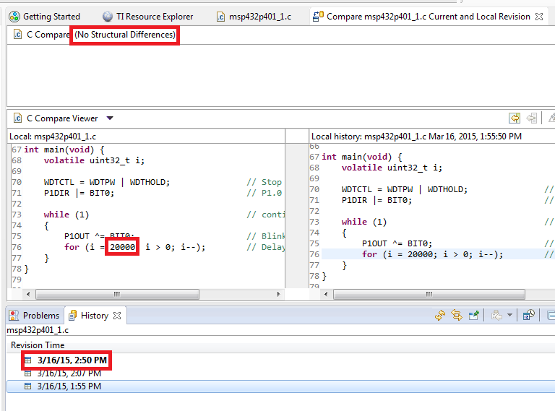
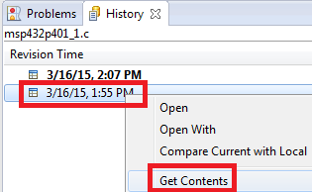
Restore From Local History
Right-click on the bottom entry in the History view and select Get Contents to restore that version of the file
Note that a new entry appears in the History view which indicates the latest (current) version and shows the same content as the bottom version
The original version of the file has beenrestored
Dr. Nabeeh Kandalaft EGR226 Grand valley State University
Notes:
15

Slide 16
Rebuild, Reload and Run the Program
Close the History view and the “diff” tool in the editor
Make sure you are in the CCS Edit perspective and project msp432p401_1 is active (in focus)
Click the Debug button to rebuild the project and reload the code
Press the Resume button to run the program
Press the Suspend button to halt the program
Dr. Nabeeh Kandalaft EGR226 Grand valley State University
Notes:
16

Slide 17
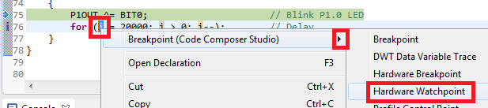

Debugging: Using Watchpoints
A Watchpoint is a type of breakpoint that monitors activity at a memory address
In this step we will set a watchpoint to halt the CPU when variable i reaches a certain value
Highlight i on line 76, right-click and select
Breakpoint -> Hardware Watchpoint in the context menu
Dr. Nabeeh Kandalaft EGR226 Grand valley State University
Notes:
17

Slide 18
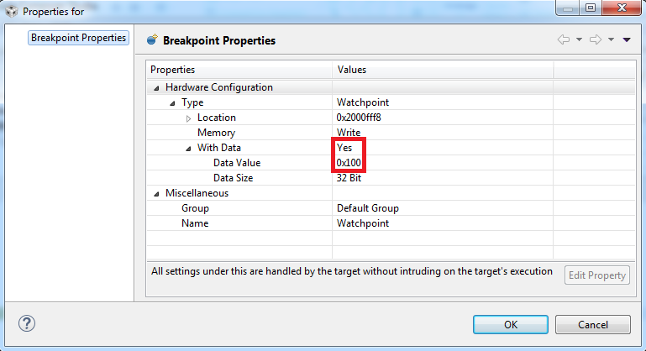
Debugging: Watchpoints
Right-click on the watchpoint in the Breakpoints view and select Breakpoint Properties in the context menu
Modify the properties to match the settings in the screenshot below
Hit OK to apply changes
Dr. Nabeeh Kandalaft EGR226 Grand valley State University
Notes:
18

Slide 19
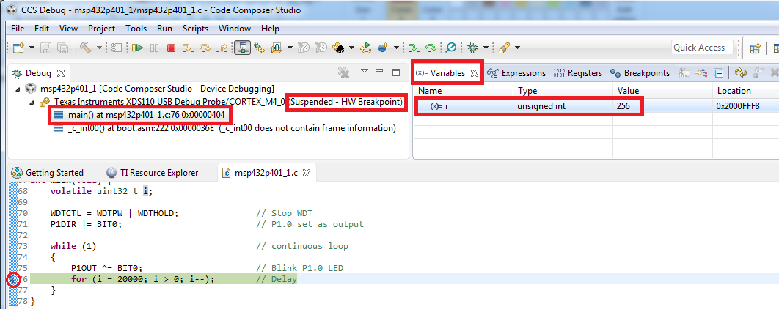
Debugging: Using Watchpoints
Run the target again and wait until the target is halted
The program will be halted at line 76
Check the value of i in the Variables view
Note that i has the value of 256 (0x100 hex)
Run the target again and note how it again halts the value of i is 256
Remove the watchpoint using the Remove All Breakpoints button in the Breakpoints view
Dr. Nabeeh Kandalaft EGR226 Grand valley State University
Notes:
19

Slide 20
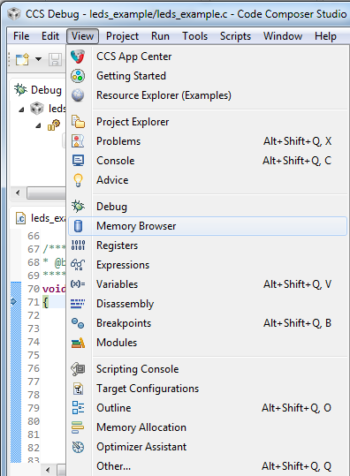
More Debugging (Review)
Investigate other debugging views (Open via View menu)
Memory Browser
Registers
Modules
Disassembly (see next slide)
Dr. Nabeeh Kandalaft EGR226 Grand valley State University
Notes:
20

Slide 21
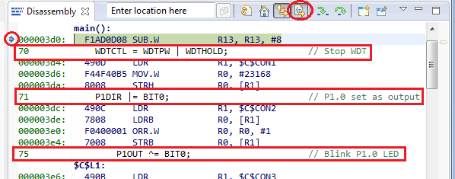
View: Disassembly
Press the Restart button to restart the program
Program should be at main
Open the disassembly view by going to View -> Disassembly
You can see the current location of the PC (small blue arrow) and any breakpoints (small blue circles)
Toggle the Show Source button
Note the toggling of interleaved source with the disassembly
Dr. Nabeeh Kandalaft EGR226 Grand valley State University
Notes:
21

Slide 22
Clean Up
Remove all breakpoints from the Breakpoints view (if any)
Terminate the Debug Session
Dr. Nabeeh Kandalaft EGR226 Grand valley State University

